Slide 1
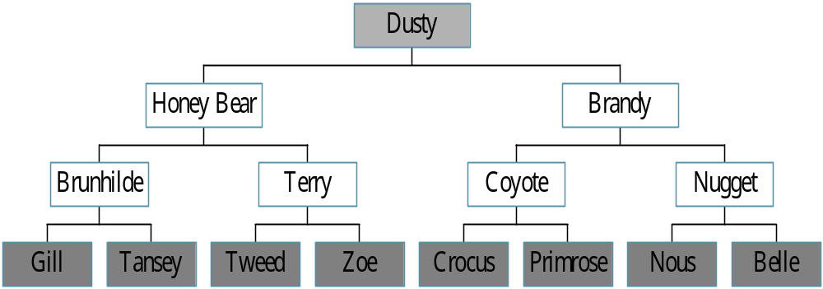
Trees
Root
leaf

Slide 2
Definition of Tree
A tree is a finite set of one or more nodes
such that:
There is a specially designated node called
the root.
The remaining nodes are partitioned into n>=0 disjoint sets T1, ..., Tn, where each of these sets is a tree.
We call T1, ..., Tn the subtrees of the root.

Slide 3
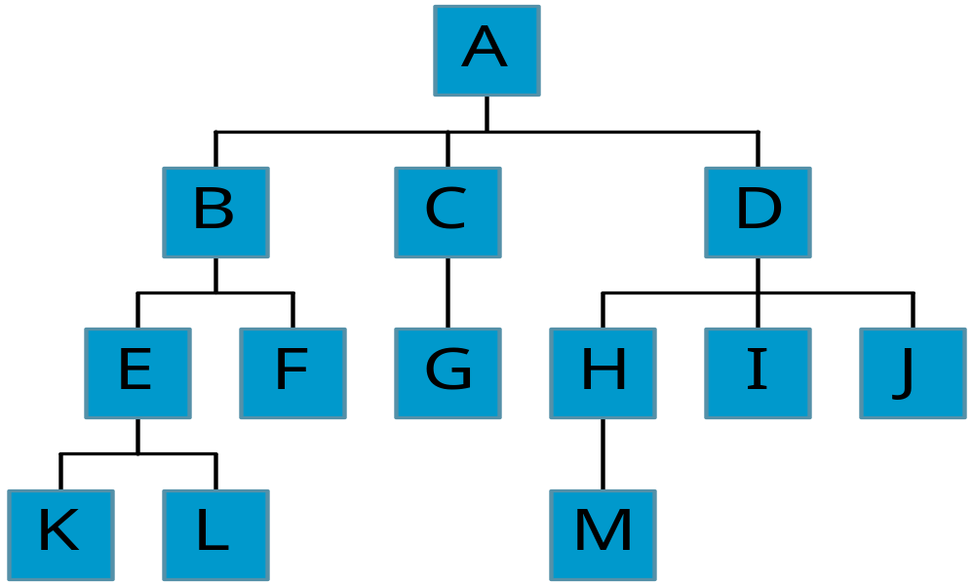
Level and Depth
Level
1
2
3
4
node (13)
degree of a node
leaf (terminal)
nonterminal
parent
children
sibling
degree of a tree (3)
ancestor
level of a node
height of a tree (4)
3
1
2
2
1
2
3
2
2
3
3
3
3
0
1
3
3
0
0
0
0
4
0
4
0
4

Slide 4
Terminology
The degree of a node is the number of subtrees
of the node
  The degree of A is 3; the degree of C is 1.
The node with degree 0 is a leaf or terminal
node.
A node that has subtrees is the parent of the
roots of the subtrees.
The roots of these subtrees are the children of
the node.
Children of the same parent are siblings.
The ancestors of a node are all the nodes
along the path from the root to the node.

Slide 5
Representation of Trees
List Representation
  ( A ( B ( E ( K, L ), F ), C ( G ), D ( H ( M ), I, J ) ) )
  The root comes first, followed by a list of sub-trees
data
link 1
link 2
...
link n
How many link fields are
needed in such a representation?

Slide 6
Left Child - Right Sibling
data
A
left child
right sibling
B
C
D
E
F
G
H
I
J
K
L
M

Slide 7
Binary Trees
A binary tree is a finite set of nodes that is
either empty or consists of a root and two
disjoint binary trees called the left subtree
and the right subtree.
Any tree can be transformed into binary tree.
  by left child-right sibling representation
The left subtree and the right subtree are distinguished.

Slide 8
*Figure 5.6: Left child-right child tree representation of a tree (p.191)
A
B
E
C
G
D
K
F
H
L
M
I
J

Slide 9
Abstract Data Type Binary_Tree
structure Binary_Tree(abbreviated BinTree) is
objects: a finite set of nodes either empty or
consisting of a root node, left Binary_Tree,
and right Binary_Tree.
functions:
for all bt, bt1, bt2 ∈ BinTree, item ∈ element
Bintree Create()::= creates an empty binary tree
Boolean IsEmpty(bt)::= if (bt==empty binary
tree) return TRUE else return FALSE

Slide 10
BinTree MakeBT(bt1, item, bt2)::= return a binary tree
whose left subtree is bt1, whose right subtree is bt2,
and whose root node contains the data item
Bintree Lchild(bt)::= if (IsEmpty(bt)) return error
else return the left subtree of bt
element Data(bt)::= if (IsEmpty(bt)) return error
else return the data in the root node of bt
Bintree Rchild(bt)::= if (IsEmpty(bt)) return error
else return the right subtree of bt

Slide 11
Samples of Trees
Complete Binary Tree
A
A
1
A
B
B
2
B
C
C
Skewed Binary Tree
3
D
E
F
G
D
4
H
I
E
5

Slide 12
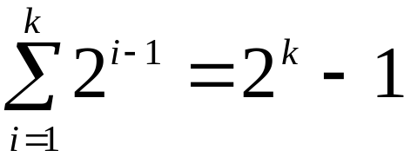
Maximum Number of Nodes in BT
The maximum number of nodes on level i of a binary tree is 2^{i-1}, i>=1.
The maximum nubmer of nodes in a binary tree
of depth k is 2^{k}-1, k>=1.
i-1
Prove by induction.

Slide 13
Full BT VS Complete BT
A full binary tree of depth k is a binary tree of
depth k having 2 -1 nodes, k>=0.
A binary tree with n nodes and depth k is
complete iff its nodes correspond to the nodes numbered from 1 to n in the full binary tree of
depth k.
k
A
A
B
C
B
C
D
E
F
G
D
E
F
G
H
H
I
J
K
L
M
N
O
I
Complete binary tree
Full binary tree of depth 4

Slide 14
Binary Tree Representations
If a complete binary tree with n nodes (depth =
log n + 1) is represented sequentially, then for
any node with index i, 1<=i<=n, we have:
  parent(i) is at i/2 if i!=1. If i=1, i is at the root and
  has no parent.
  left_child(i) ia at 2i if 2i<=n. If 2i>n, then i has no
  left child.
  right_child(i) ia at 2i+1 if 2i +1 <=n. If 2i +1 >n,
  then i has no right child.

Slide 15
Sequential Representation
[1]
[2]
[3]
[4]
[5]
[6]
[7]
[8]
[9]
A
B
C
D
E
F
G
H
I
(1) waste space
(2) insertion/deletion
problem
A
[1]
[2]
[3]
[4]
[5]
[6]
[7]
[8]
[9]
.
[16]
A
B
--
C
--
--
--
D
--
.
E
B
A
C
B
C
D
D
E
F
G
E
H
I

Slide 16
Linked Representation
typedef struct node *tree_pointer;
typedef struct node {
int data;
tree_pointer left_child, right_child;
};
data
left_child
data
right_child
left_child
right_child

Slide 17
Binary Tree Traversals
Let L, V, and R stand for moving left, visiting
the node, and moving right.
There are six possible combinations of traversal
  LVR, LRV, VLR, VRL, RVL, RLV
Adopt convention that we traverse left before
right, only 3 traversals remain
  LVR, LRV, VLR
  inorder, postorder, preorder

Slide 18
Arithmetic Expression Using BT
+
inorder traversal
A / B * C * D + E
infix expression
preorder traversal
+ * * / A B C D E
prefix expression
postorder traversal
A B / C * D * E +
postfix expression
level order traversal
+ * E * D / C A B
*
E
*
D
/
C
A
B

Slide 19
Inorder Traversal (recursive version)
void inorder(tree_pointer ptr)
/* inorder tree traversal */
{
if (ptr) {
inorder(ptr->left_child);
printf(“%d”, ptr->data);
indorder(ptr->right_child);
}
}
A / B * C * D + E

Slide 20
Preorder Traversal (recursive version)
void preorder(tree_pointer ptr)
/* preorder tree traversal */
{
if (ptr) {
printf(“%d”, ptr->data);
preorder(ptr->left_child);
predorder(ptr->right_child);
}
}
+ * * / A B C D E

Slide 21
Postorder Traversal (recursive version)
void postorder(tree_pointer ptr)
/* postorder tree traversal */
{
if (ptr) {
postorder(ptr->left_child);
postdorder(ptr->right_child);
printf(“%d”, ptr->data);
}
}
A B / C * D * E +

Slide 22
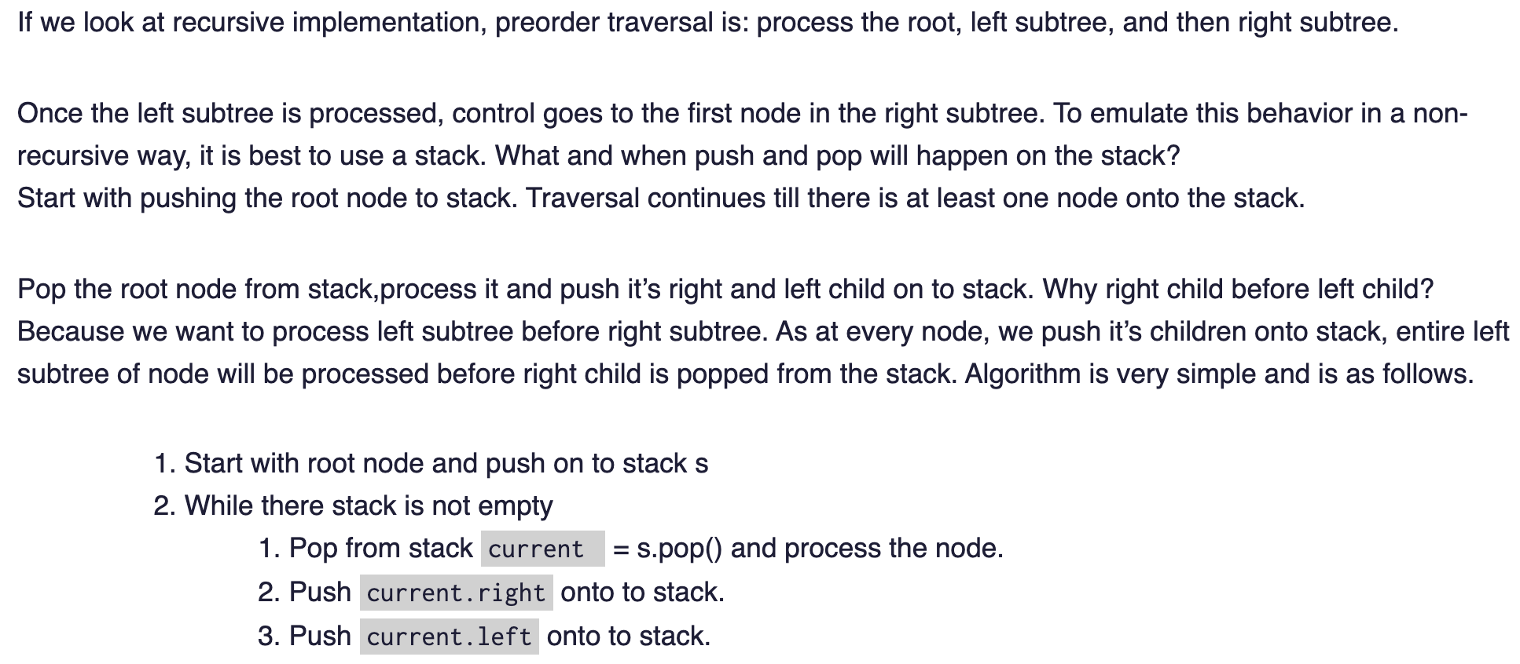
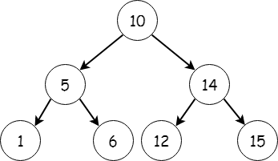
Iterative preorder Traversal
(using stack)

Slide 23
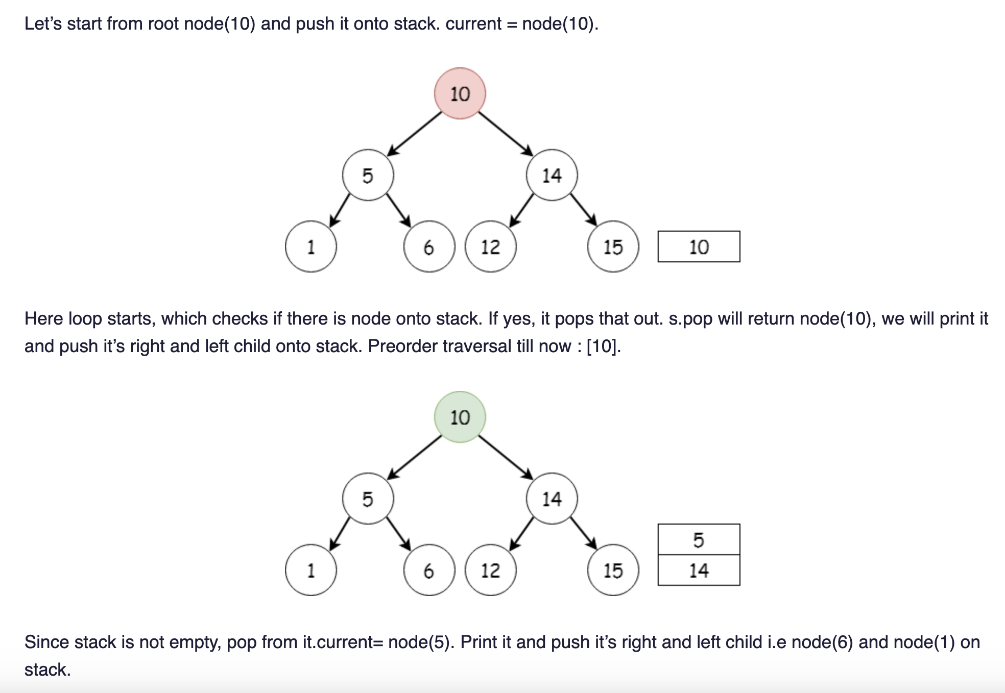
Iterative preorder Traversal(using stack)

Slide 24
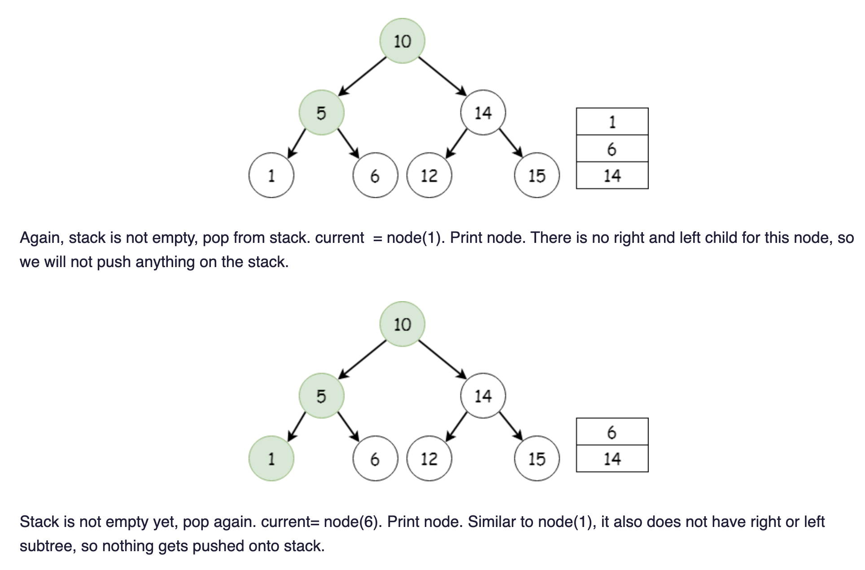

Slide 25
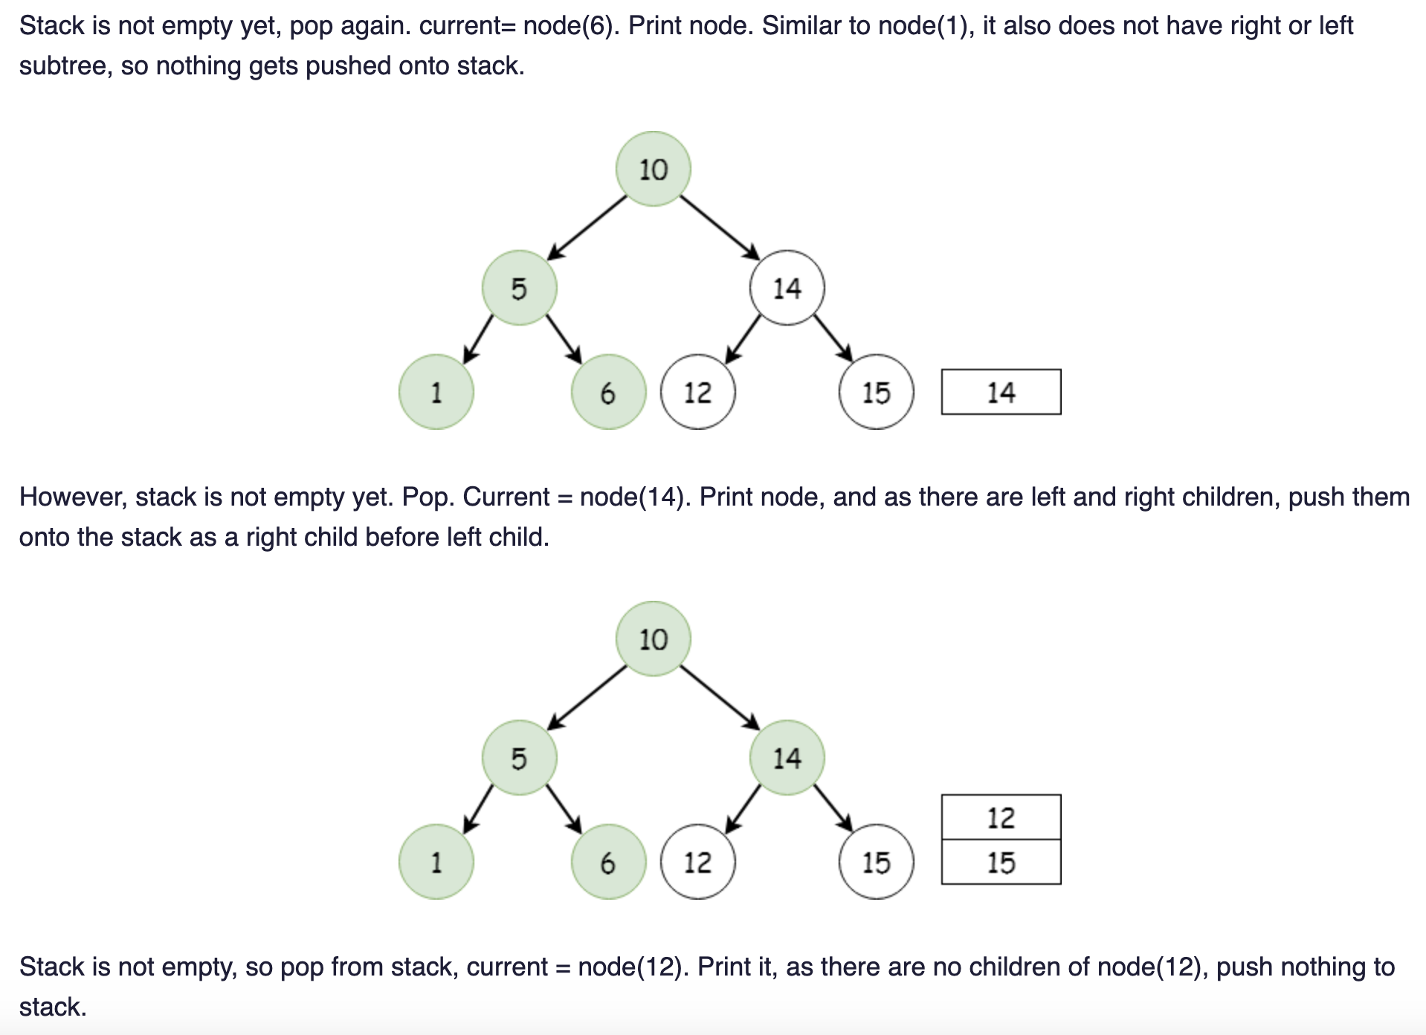

Slide 26
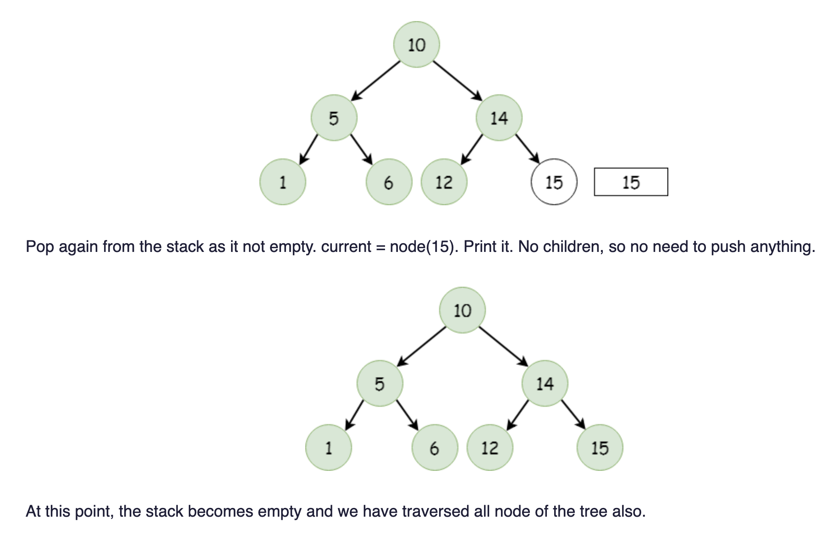
Ref: http://www.algorithmsandme.com/iterative-preorder-traversal/

Slide 27
Threaded Binary Trees
Two many null pointers in current representation
of binary trees
n: number of nodes
number of non-null links: n-1
total links: 2n
null links: 2n-(n-1)=n+1
Replace these null pointers with some useful “threads”.

Slide 28
Threaded Binary Trees (Continued)
If ptr->left_child is null,
replace it with a pointer to the node that would be
visited before ptr in an inorder traversal
If ptr->right_child is null,
replace it with a pointer to the node that would be
visited after ptr in an inorder traversal

Slide 29
A Threaded Binary Tree
root
A
dangling
B
C
dangling
D
E
F
G
inorder traversal:
H, D, I, B, E, A, F, C, G
H
I

Slide 30
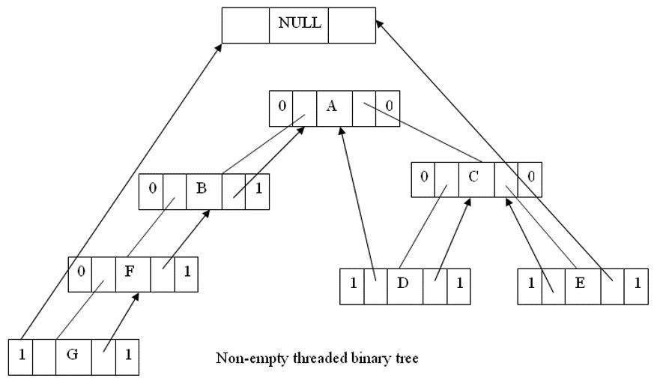

Slide 31
Threaded binary Tree
• One way threading:- A thread will appear in a right field of a node and will point to the next node in the inorder traversal.
• Two way threading:- A thread will also appear in the left field of a node and will point to the preceding node in the inorder traversal.

Slide 32
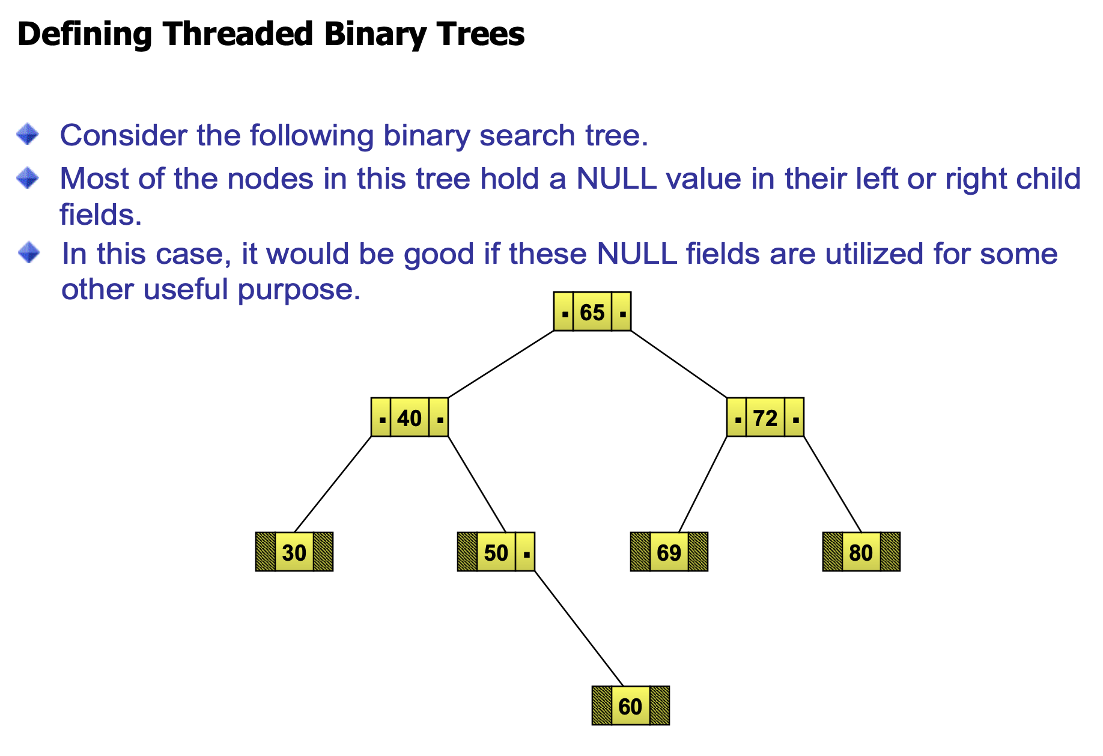

Slide 33
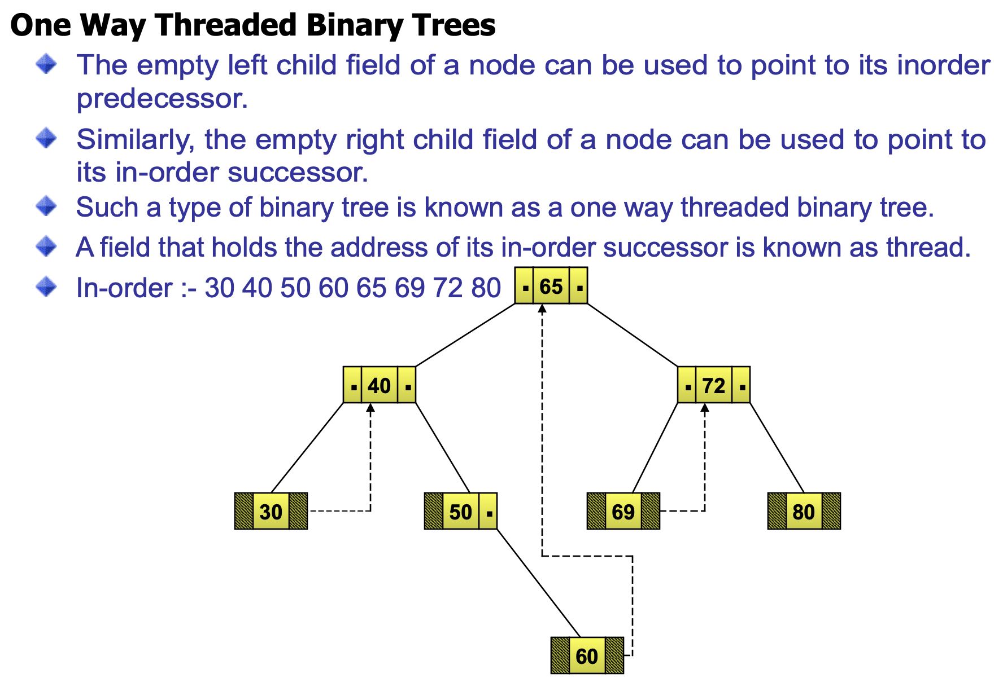

Slide 34
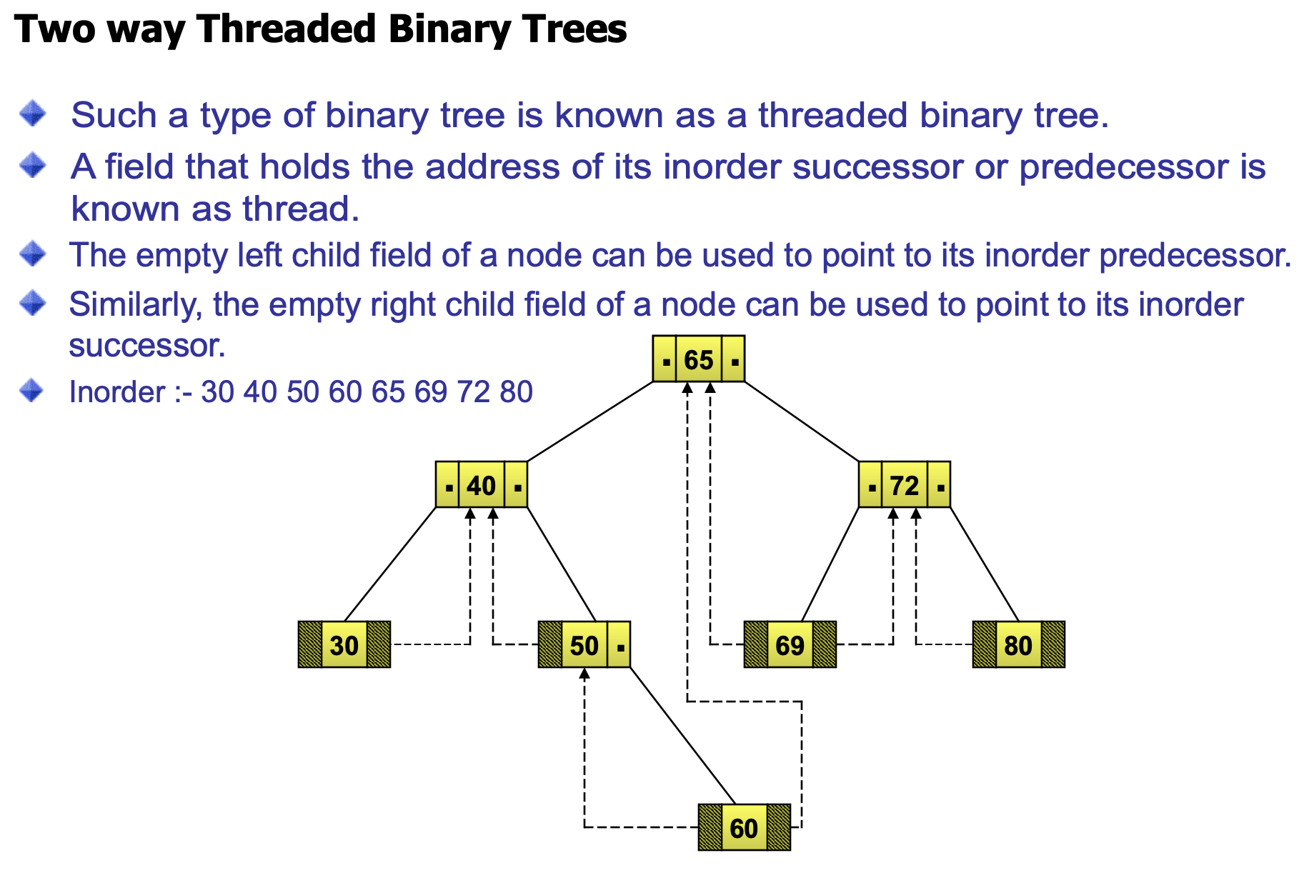

Slide 35
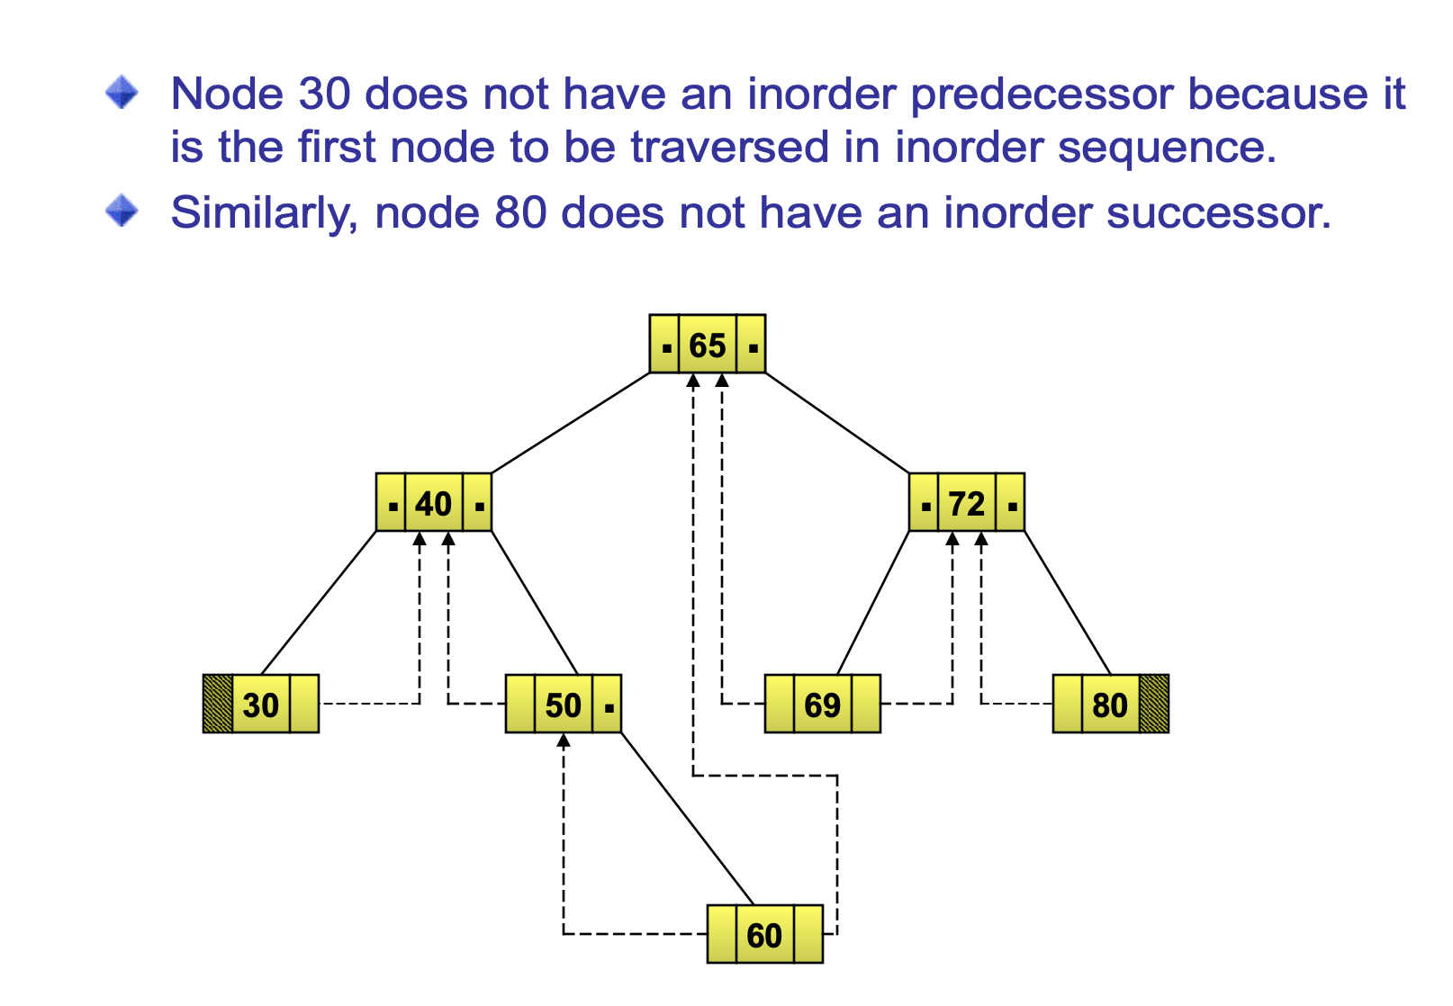

Slide 36
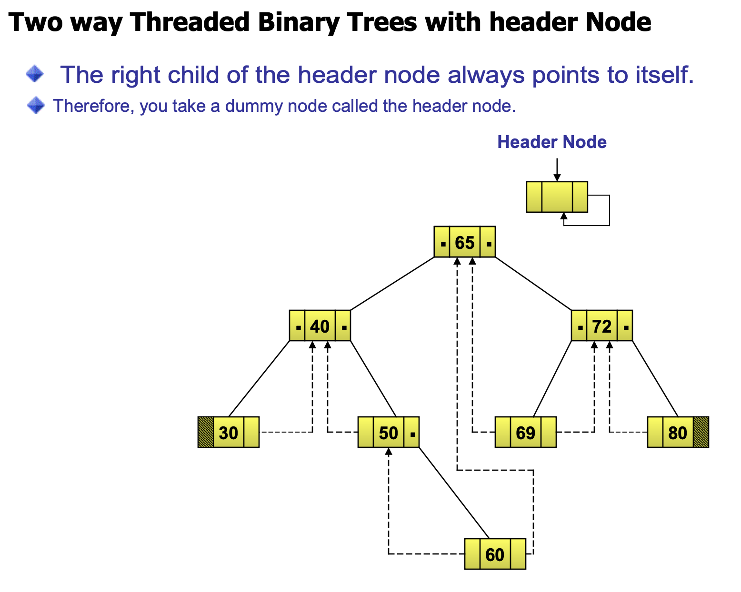

Slide 37
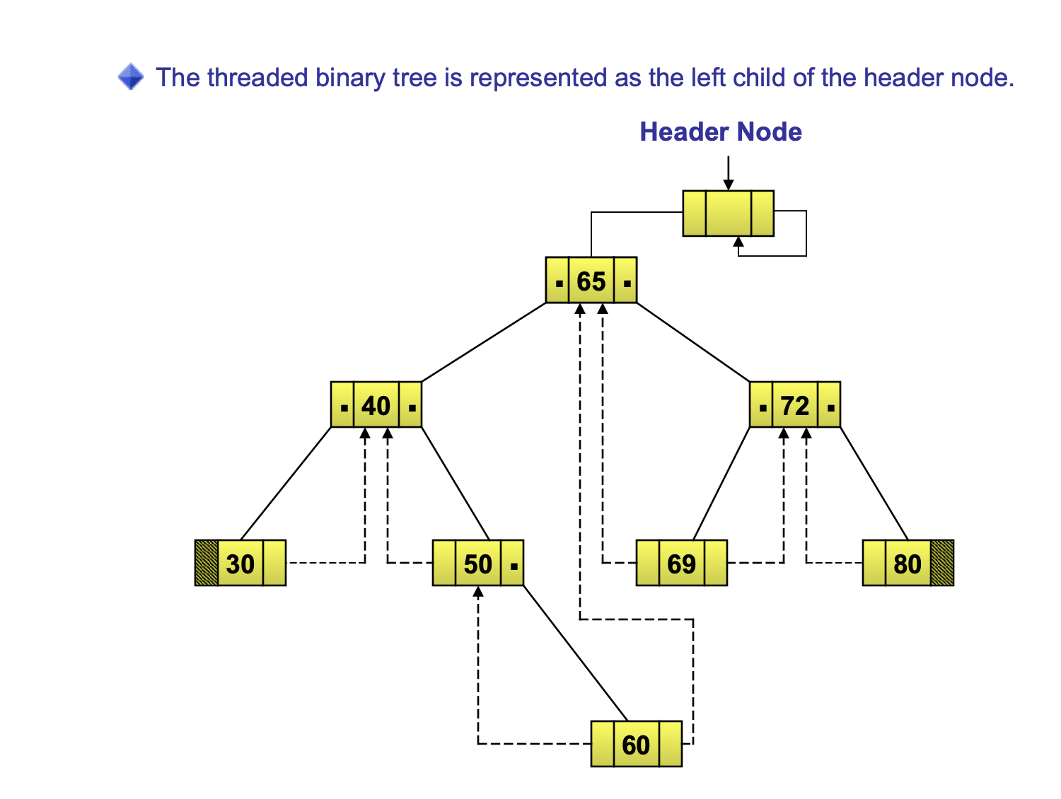

Slide 38
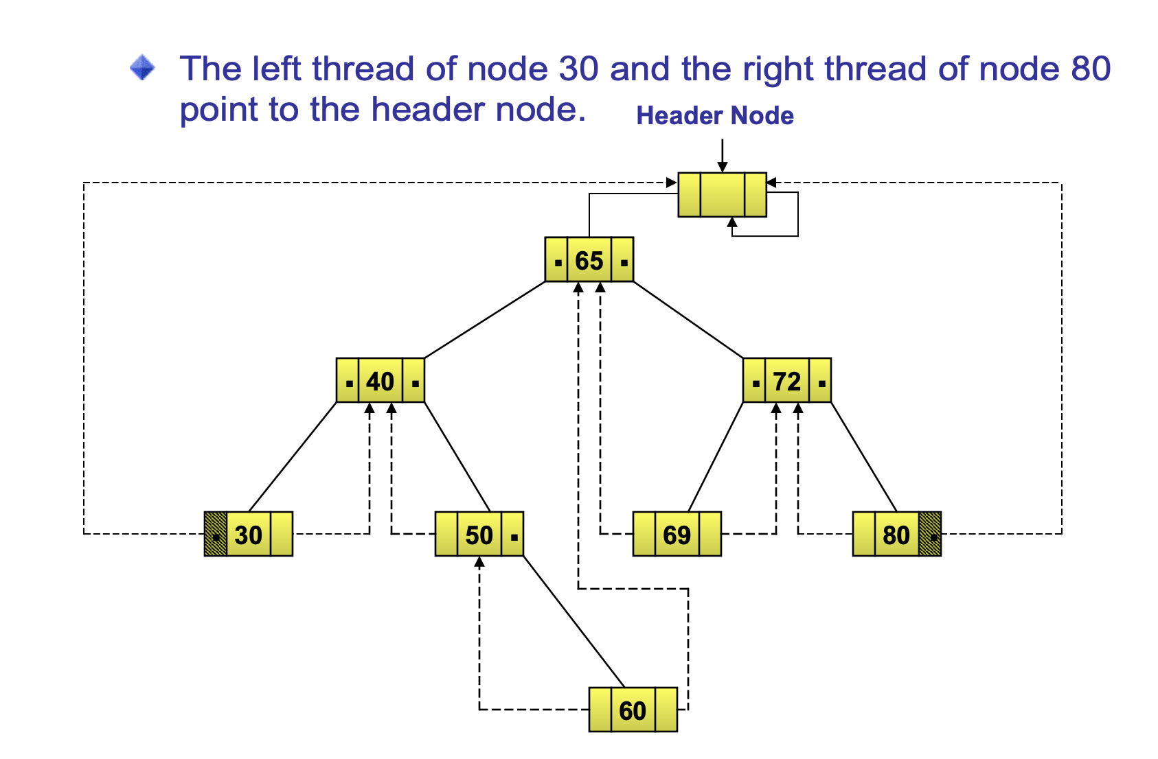

Slide 39
Data Structures for Threaded BT
left_thread left_child data right_child right_thread
TRUE
●
●
FALSE
TRUE: thread
FALSE: child
typedef struct threaded_tree *threaded_pointer;
typedef struct threaded_tree {
short int left_thread;
threaded_pointer left_child;
char data;
threaded_pointer right_child;
short int right_thread; };

Slide 40
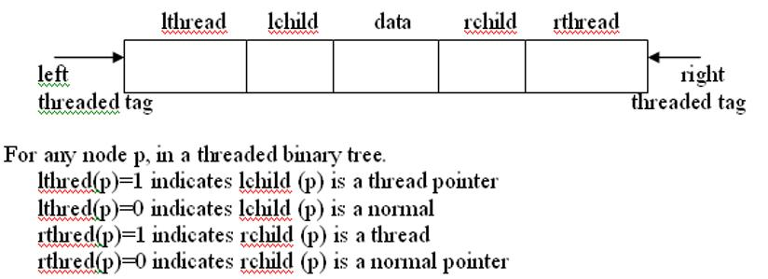

Slide 41
Memory Representation of A Threaded BT
root
--
f
f
f
A
f
f
B
f
f
C
f
f
D
f
t
E
t
t
F
t
t
G
t
t
H
t
t
I
t

Slide 43
Next Node in Threaded BT
threaded_pointer insucc(threaded_pointer tree)
{
threaded_pointer temp;
temp = tree->right_child;
if (!tree->right_thread)
while (!temp->left_thread)
temp = temp->left_child;
return temp;
}

Slide 44
Inorder Traversal of Threaded BT
void tinorder(threaded_pointer tree)
{
/* traverse the threaded binary tree inorder */
threaded_pointer temp = tree;
for (;;) {
temp = insucc(temp);
if (temp==tree) break;
printf(“%3c”, temp->data);
}
}
O(n)

Slide 45
Inserting Nodes into Threaded BTs
Insert child as the right child of node parent
  change parent->right_thread to FALSE
  set child->left_thread and child->right_thread to TRUE
  set child->left_child to point to parent
  set child->right_child to parent->right_child
  change parent->right_child to point to child

